Slide 1

IAS Analytics Challenge
Round 1
Employment Database
Team member:
Sachin Rangegowda
Rohit Choudhary
Madhuri Kashyap
Raviteja Kondubhatla
The University of Texas at Dallas
utdallas.edu

Slide 2
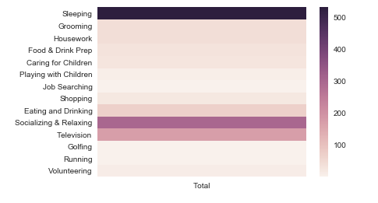
Question 1: Sleep, Socialize, TV, Repeat!
Activities:
Sleeping
Socializing
Television
Others
Software: Python

Slide 3
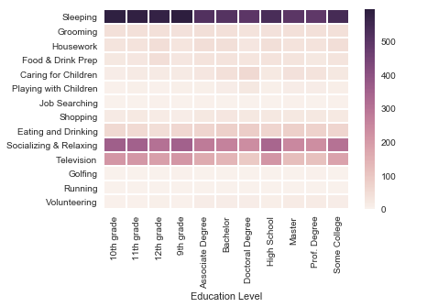
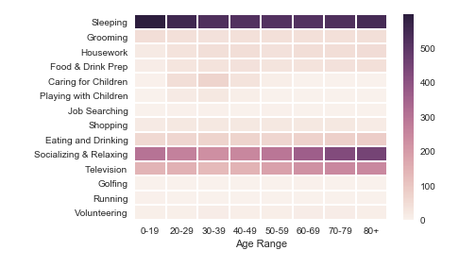
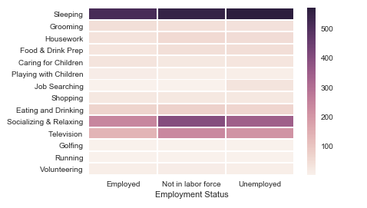
Question 2: Time Spent On Various Activities Based on Age, Employment Status and Education Level
People who are not in the labor force are mostly relaxing and watching TV when compared to the employed and unemployed population
People in high school seem to spend more time on TV than the ones holding professional degrees
Caring for children is an important activity for people in 30s
Socializing is prevalent among the people below 20 and above 60 years old
However, television viewership is confined to baby boomer generation

Slide 4
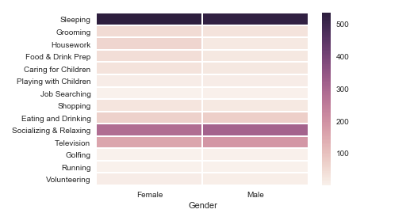
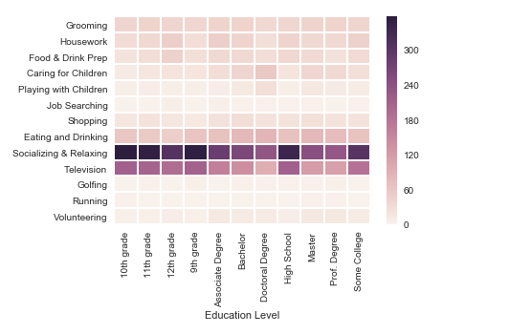
Question 2: Continuation
(without ‘sleeping’)
Analysis: Based on gender, females are spending more time on housework, grooming, food preparation and caring for children than that of the males. Males are spending a little more time watching TV as compared to females. However, both the genders are equally socializing, relaxing, eating and drinking during the given time period.

Slide 5
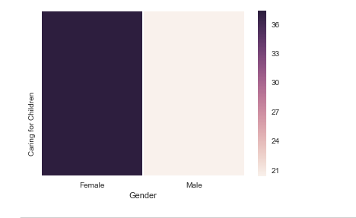
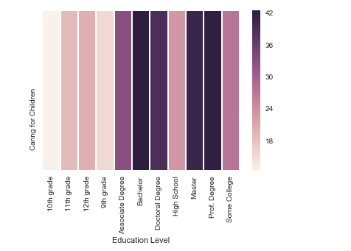
Question 3: Kids love the working mommies!
Analysis:
32% of the females and 21% of the males in the dataset spend time caring children
Caring for children is most popular among the bachelor degree and professional degree holders followed by masters and doctoral degree students. People seem to stay away from kids before entering college
There is no correlation observed between employment status and caring for children

Slide 6
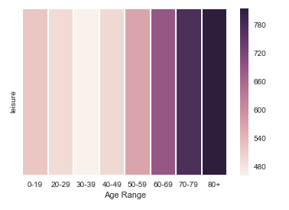
Question 4: Oldies are laziest
Leisure times are mostly enjoyed by people above 50 years. Among the younger generations people below 20s have more leisure time compared to middle aged people
We can see that people in the 30’s have less leisure time due to other activities

Slide 7
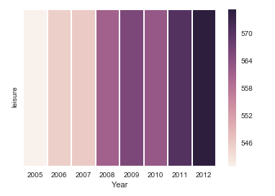
Question 5: Recession made people sit indoors!
Analysis:
The leisure time of the people suddenly spiked in 2012 and stood highest among all the years in the given dataset
We can also observe that in 2010 there is slight dip in the leisure time, but it bounced back strongly in later years.
Shopping decreased by 6% and housework increased by 5%. Also, playing with children, sleeping increased while volunteering, running and food & drink preparations decreased during 2012

Slide 8
Question 6: Sleeping is the most favorite activity! What else?
The major activities like sleeping, socializing & relaxing, television, eating & drinking have been factorized and removed for this analysis as they are common for all ages and the other activities seemed differing by age

Slide 9
Question 7: Significant Variables – ‘Socializing & Relaxing’ Matters
Analysis:
As per multinomial logistic regression, the significant variables are as follows:
Sleeping
Housework
Food & Drink Prep
Caring for Children
Job Searching
Eating and Drinking
Socializing & Relaxing
Using the variables above, decision tree algorithm is used to know the relative significance of the variables

Slide 10
Question 8: Prediction Time!
Analysis:
Multinomial Logistic Regression is used in the training Dataset to determine the impact of various variables on the Employment status.
Most of the variables are used to determine the Employment status
Excel contains predicted value of Employment status for the testing dataset

Slide 11
Appendix (Additional Analysis)

